Slide 1

Inclusive Educational Software System: Emotionally Expressive Reading for Children with Disabilities (Blind, Deaf, Cognitive Impairments)
25-26J-407

Slide 2

IT22153104 | ILANGEERAN I
Children with cognitive impairments struggle And Solution
Information Technology
IT22153104 | Ilangeeran I | 25-26J-407

Slide 3
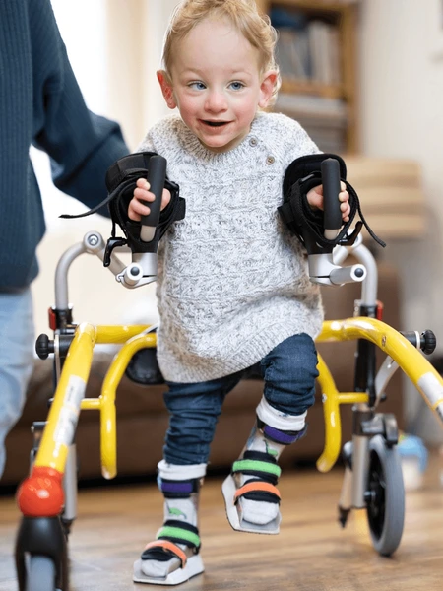
Children with cognitive impairments struggle And Solution
Problem:
Children with cognitive impairments struggle to understand complex texts due to difficult vocabulary and long sentences.
Existing reading tools lack personalization and emotional engagement, making learning less effective
Solution:
Develop an inclusive NLP-based system that simplifies and summarizes text in real time
Integrate emotion-aware storytelling (expressive speech + adaptive content) to enhance comprehension and engagement for children with disabilities
IT22153104 | Ilangeeran I | 25-26J-407

Slide 4
Compare with Existing system
Feature | Existing system | Our System
Focus | Provides standard books or e-books with no adaptation for cognitive impairments. | Simplifies text and summarizes stories to match the child’s comprehension level.
Accessibility | Mostly designed for neurotypical learners; lacks accessibility for children with cognitive impairments. | Designed inclusively for children with disabilities (cognitive, visual, hearing) with multi-sensory support (speech + visuals).
Adaptability | Static and fixed content; no adjustment during storytelling. | Real-time adaptation: explains more when confusion is detected, adds interactivity if child looks bored.
Learning | Doesn’t improve over time, keeps using the same knowledge. | Learns from user feedback and real cases, so it keeps getting smarter.
IT22153104 | Ilangeeran I | 25-26J-407

Slide 5


Children with cognitive impairments struggle And Solution
Tools & Technologies
Languages
Python, Java Script
Storage
PSQL, Vector DB
Federated learning
FATE – Industrial-grade FL platform.
OpenFL – Intel’s healthcare-focused FL framework.
Clara FL – NVIDIA’s GPU-accelerated FL for medicine.
PaddleFL – Baidu’s FL toolkit for large-scale apps.
IT22153104 | Ilangeeran I | 25-26J-407

Slide 6
Children with cognitive impairments struggle And Solution
Model Performance Evaluation
Simplification Accuracy & Readability Score
Summarization Precision & Recall
Emotion Detection Accuracy
Expected Success Criteria
Comprehension Improvement
Engagement & Emotional Responsiveness
IT22153104 | Ilangeeran I | 25-26J-407

Slide 7
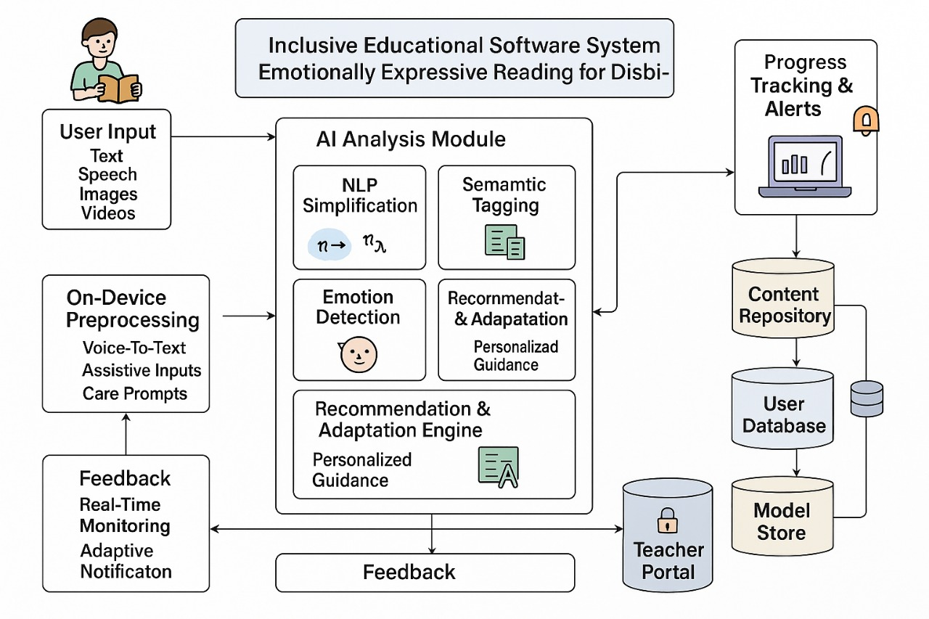
Children with cognitive impairments struggle And Solution
Component Diagram
IT22153104 | Ilangeeran I | 25-26J-407

Slide 8
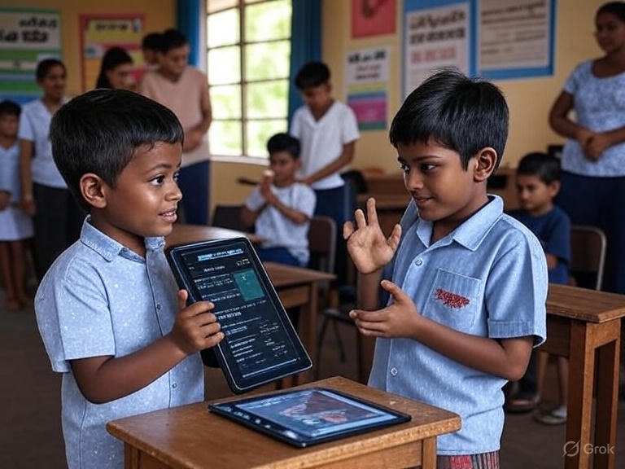
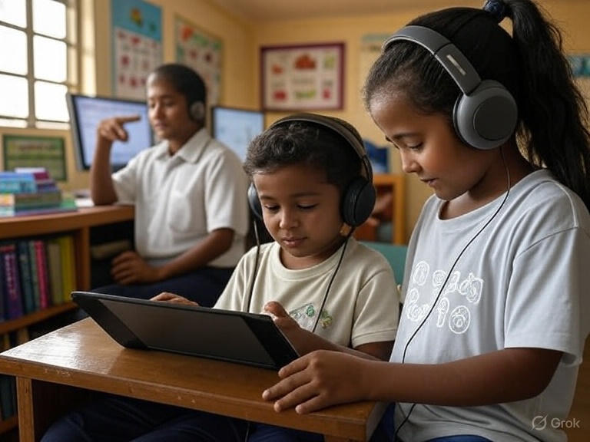
Children with cognitive impairments struggle And Solution
Real world scenario
IT22153104 | Ilangeeran I | 25-26J-407

